Slide 2
Digital Forensics Lecture-8
By- Dr.subhranil Das
Assistant Professor
School of computer Science

Slide 3
Unit-2
Techniques for acquiring digital evidence from various sources:
Computers (Digital Formats, Image Acquisition, Image Formats, RAID)
mobile devices (Mobile Forensics)
cloud environments (Cloud Forensics)
Chain of custody
Preservation of digital evidence
Hands-on exercises: acquiring and preserving digital evidence using forensic tools.

Slide 4

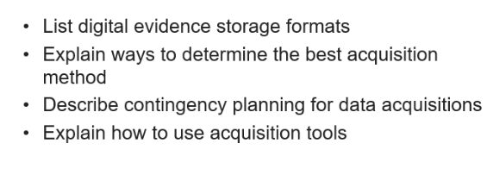
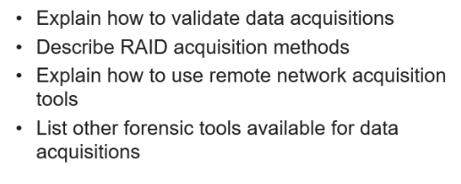
Objectives

Slide 5
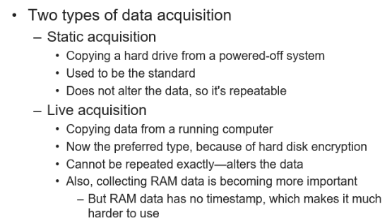
Understanding Storage Formats for Digital Evidence

Slide 6
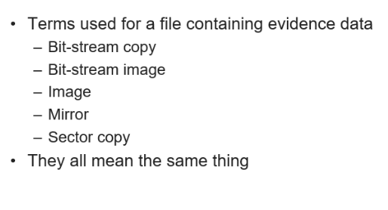
Understanding Storage Formats for Digital Evidence

Slide 7
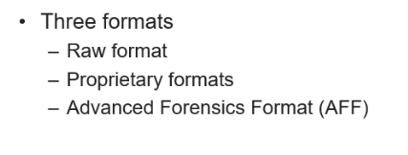
Understanding Storage Formats for Digital Evidence

Slide 8
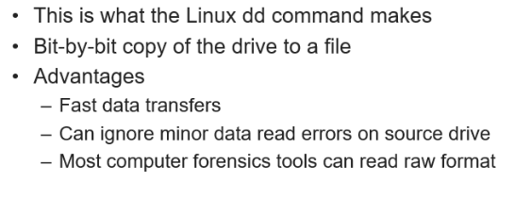
Raw Format

Slide 9
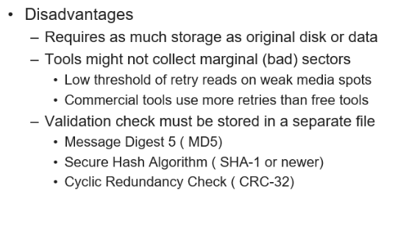
Raw Format

Slide 10
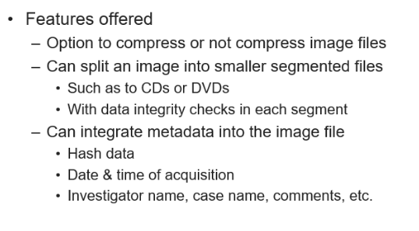
Propriety Format

Slide 11
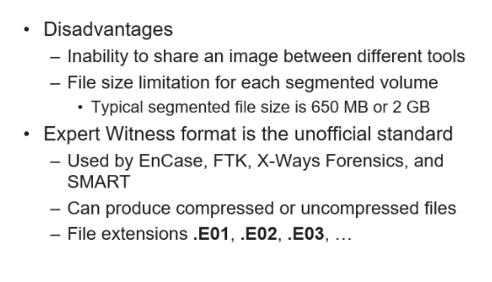
Propriety Format

Slide 12
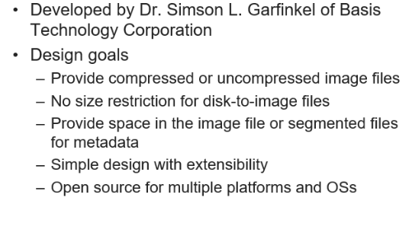
Advanced Forensics Format (AFF)

Slide 13
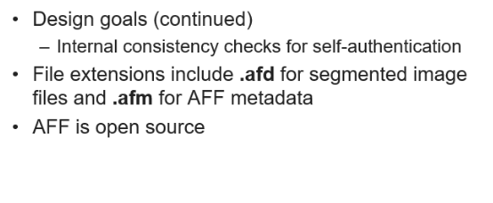
Advanced Forensics Format (AFF)

Slide 14
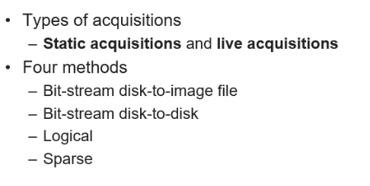
Determine the Best Acquisition Method

Slide 15
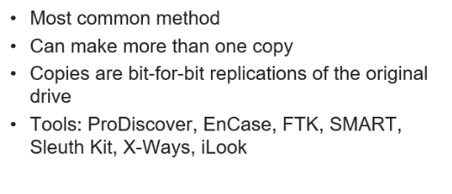
Bit Stream Disk to image file

Slide 16
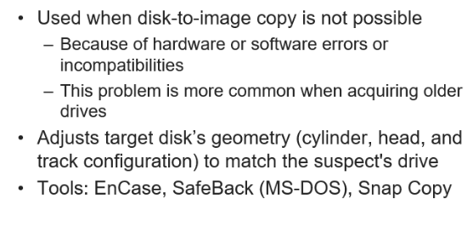
Bit stream disk to disk

Slide 17
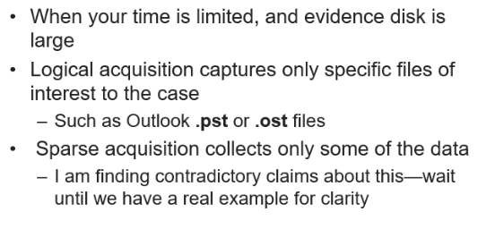
Logical Acquisition and Sparse Acquisition

Slide 18
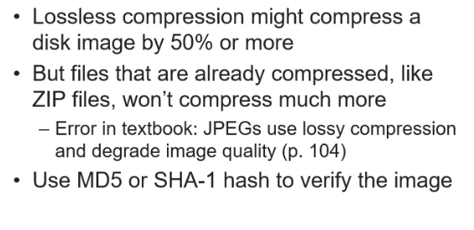
Compressing Disk Images

Slide 19
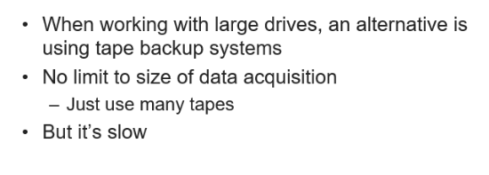
Tape Backup

Slide 20
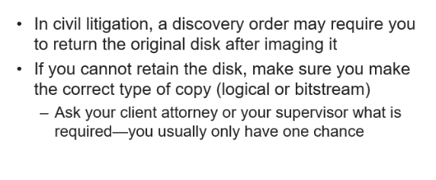
Returning Evidence Drives

Slide 21
Case 5: Auction Fraud
A buyer on eBay complained to police that he sent a cashier’s check to that seller but received no merchandise.
Over a period of weeks, several dozen similar reports were made to the Internet Fraud Complaint Center against the same seller.
To hide his identity, the seller used a Hotmail account for online communications and several mail drops to receive checks.
Logs obtained from Hotmail revealed that the seller was accessing the Internet through a subsidiary of Uunet.
When served with a subpoena, Uunet disclosed the suspect’s MSN account and associated address, credit card, and telephone numbers.

Slide 22
Case 5: Auction Fraud
Investigators also obtained information from the suspect’s bank with a subpoena to determine that the cashier’s checks from the buyers had been deposited into the suspect’s bank account.
A subpoena to eBay for auction history and complaints and supporting evidence from each of the buyers helped corroborate the connections between the suspect and the fraudulent activities.
Employees at each mail drop recognized a photograph of the suspect obtained from the Department of Motor Vehicles.
A subpoena to the credit card company revealed the suspect’s Social Security number and a search of real estate property in the suspect’s name turned up an alternate residence where he conducted most of his fraud.

Slide 23
Next Lecture
Digital Evidence Acquisition

